Slide 1
Transana

Slide 2
General
For qualitative analysis
Transana is cross-platform. Runs on both Windows and Apple OS X
Transana is Open Source.
Researchers can adapt the software to their own special needs if necessary
Transana was originally created by Chris Fassnacht.
It is now developed and maintained by David K. Woods at the Wisconsin Center for Education Research, University of Wisconsin-Madison.
Newest version: Transana 2.30 (10/29/2008)
No longer free!
In 10 languages
English, Danish, Dutch, French, German, Italian, Norwegian, Russian, Spanish, and Swedish
Does 4 things: transcription, clip creation, coding, and writing analytic memos

Slide 3
Transcription
1st load video; then create a transcription
Transana allows you to associate multiple transcripts with each video
Transana supports Jeffersonian Notation, a formal system of codes
Transana allows you to enter "time codes" as part of the process of creating your transcript(s)

Slide 4
Clip Creation & Keywords
All coding in Transana is done at the clip level
Clips
Assign keywords to clips
Each clip can have multiple keywords
Quick Clips
Quick clips are not named by the researcher during creation and are not initially placed in any theory-bound collection. This allows the researcher to defer these tasks to later in the analytic process, after an initial theoretical understanding has had time to emerge from the data
Keyword maps/graphs (JPG file)
Visual patterns

Slide 5
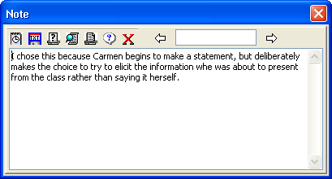
Analytic Memoing
Analytic memoing allows a researcher to create descriptions of analytic content and process which document analytic decisions
Facilitated through the use of Notes.
Notes are plain text records which can be attached to series, episode, transcript, collection and clip records
The Notes Browser views all analytic notes in one place.

Slide 6
Other Features
Video encryption for safe transfer of files
Presentation mode allows excerpts of video data (Transana clips) to be used with presentation software
Transana has a multi-user version: Transana-MU
allowing data to be shared by many researchers at once, even if those researchers are not in the same location. Changes made by one researcher are instantaneously reflected on screen of all other researchers

